Slide 1


Slide 2
Randomized Controlled Trial
April 2 0 2 3
Measuring impact of development programs
Soumya Kochhat
Research Manager, IPA Philippines

Slide 3


Agenda
RCT - what and why?
How to design an RCT?
When (not) to run an RCT?
Thought exercise: designing RCT for a fictional program
R exercise: analyze RCT results

Slide 4
What do we mean by “impact”?

Slide 5
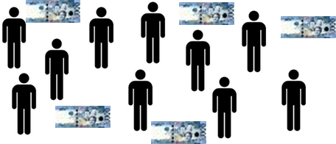
Understanding Impact
Have you ever wondered…
how would beneficiaries have fared had a program/policy never been implemented?

Slide 6


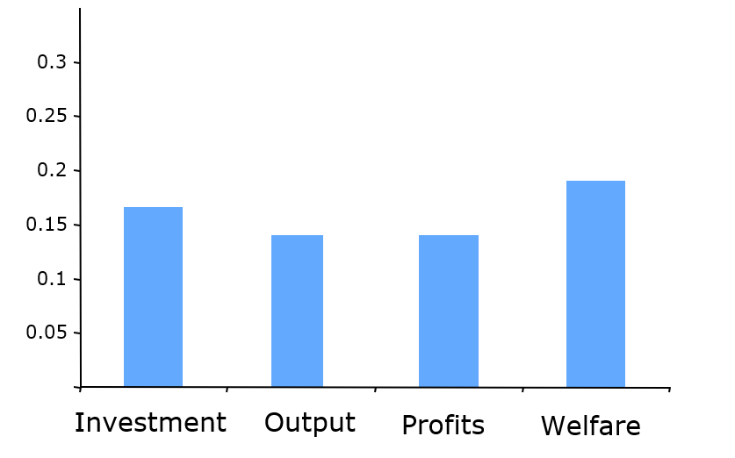
Understanding Impact
With program
Without program
IMPACT
The one difference: one group receives the program.
Employability Employment Income Welfare
outcomes of interest

Slide 7
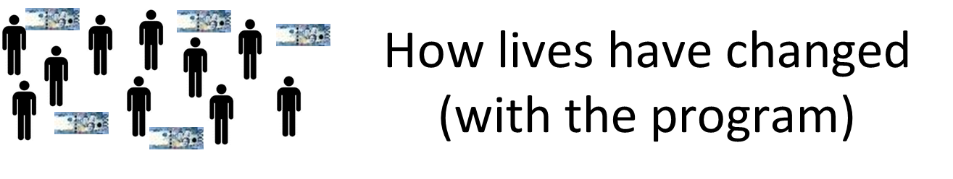


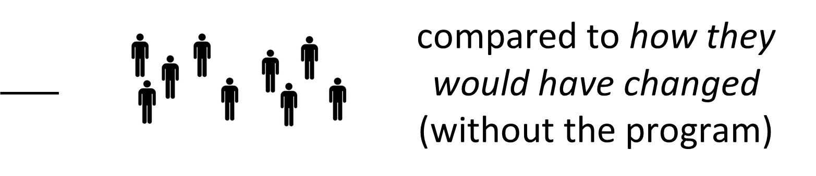

Understanding Impact

Slide 8

Understanding Impact
Counterfactual: represents the state of the world that program participants would have experienced in the absence of the program (i.e. had they not participated in the program)

Slide 9
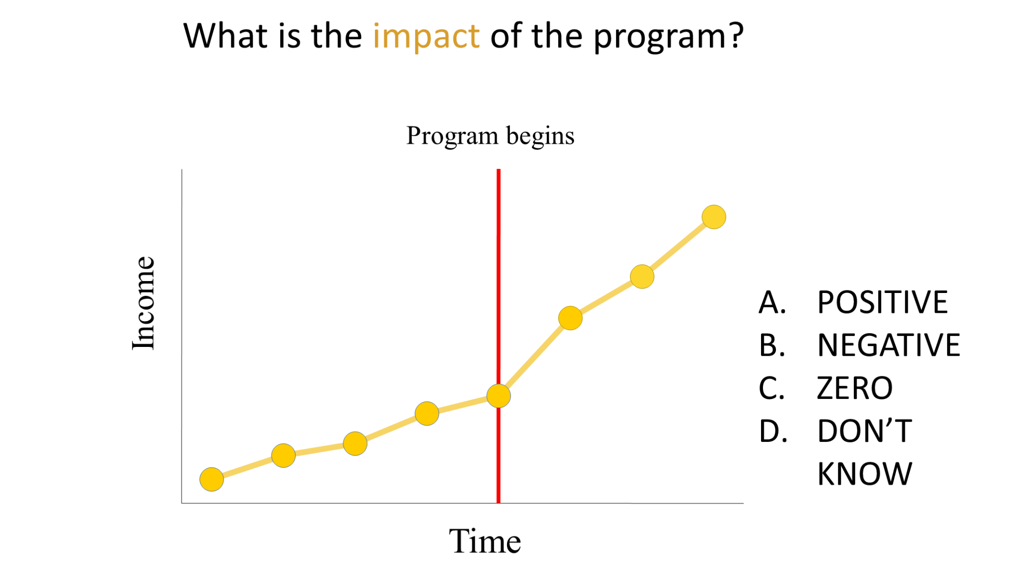
Understanding Impact

Slide 10
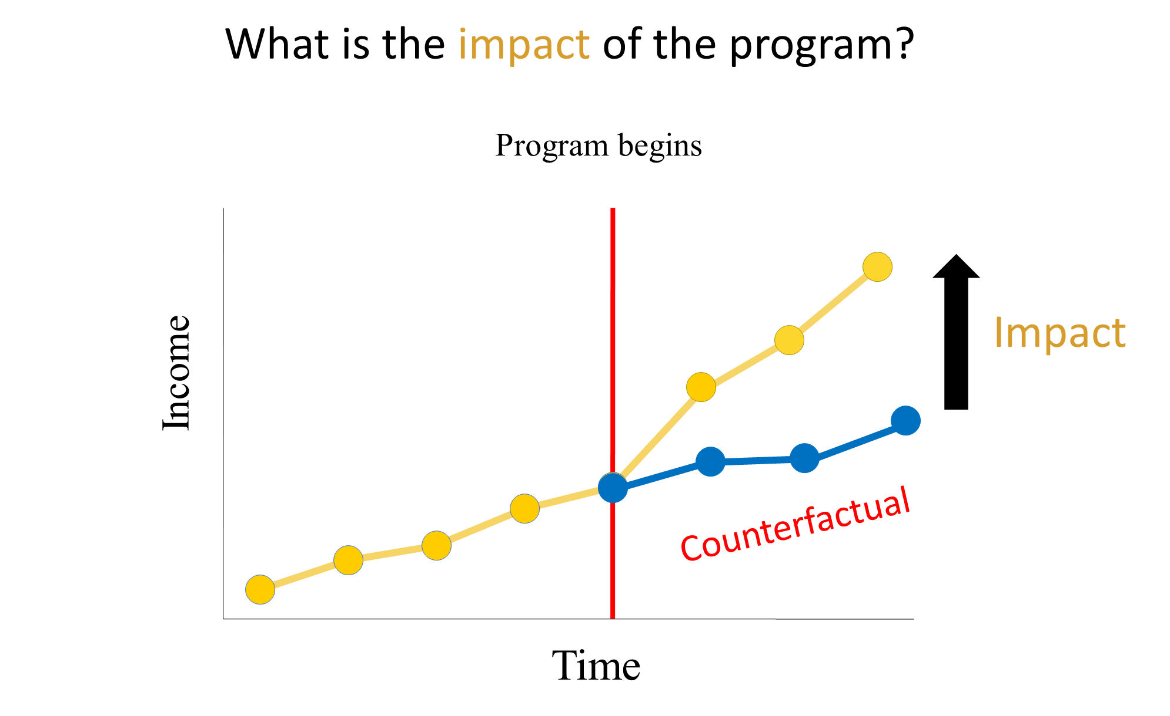
Understanding Impact

Slide 11
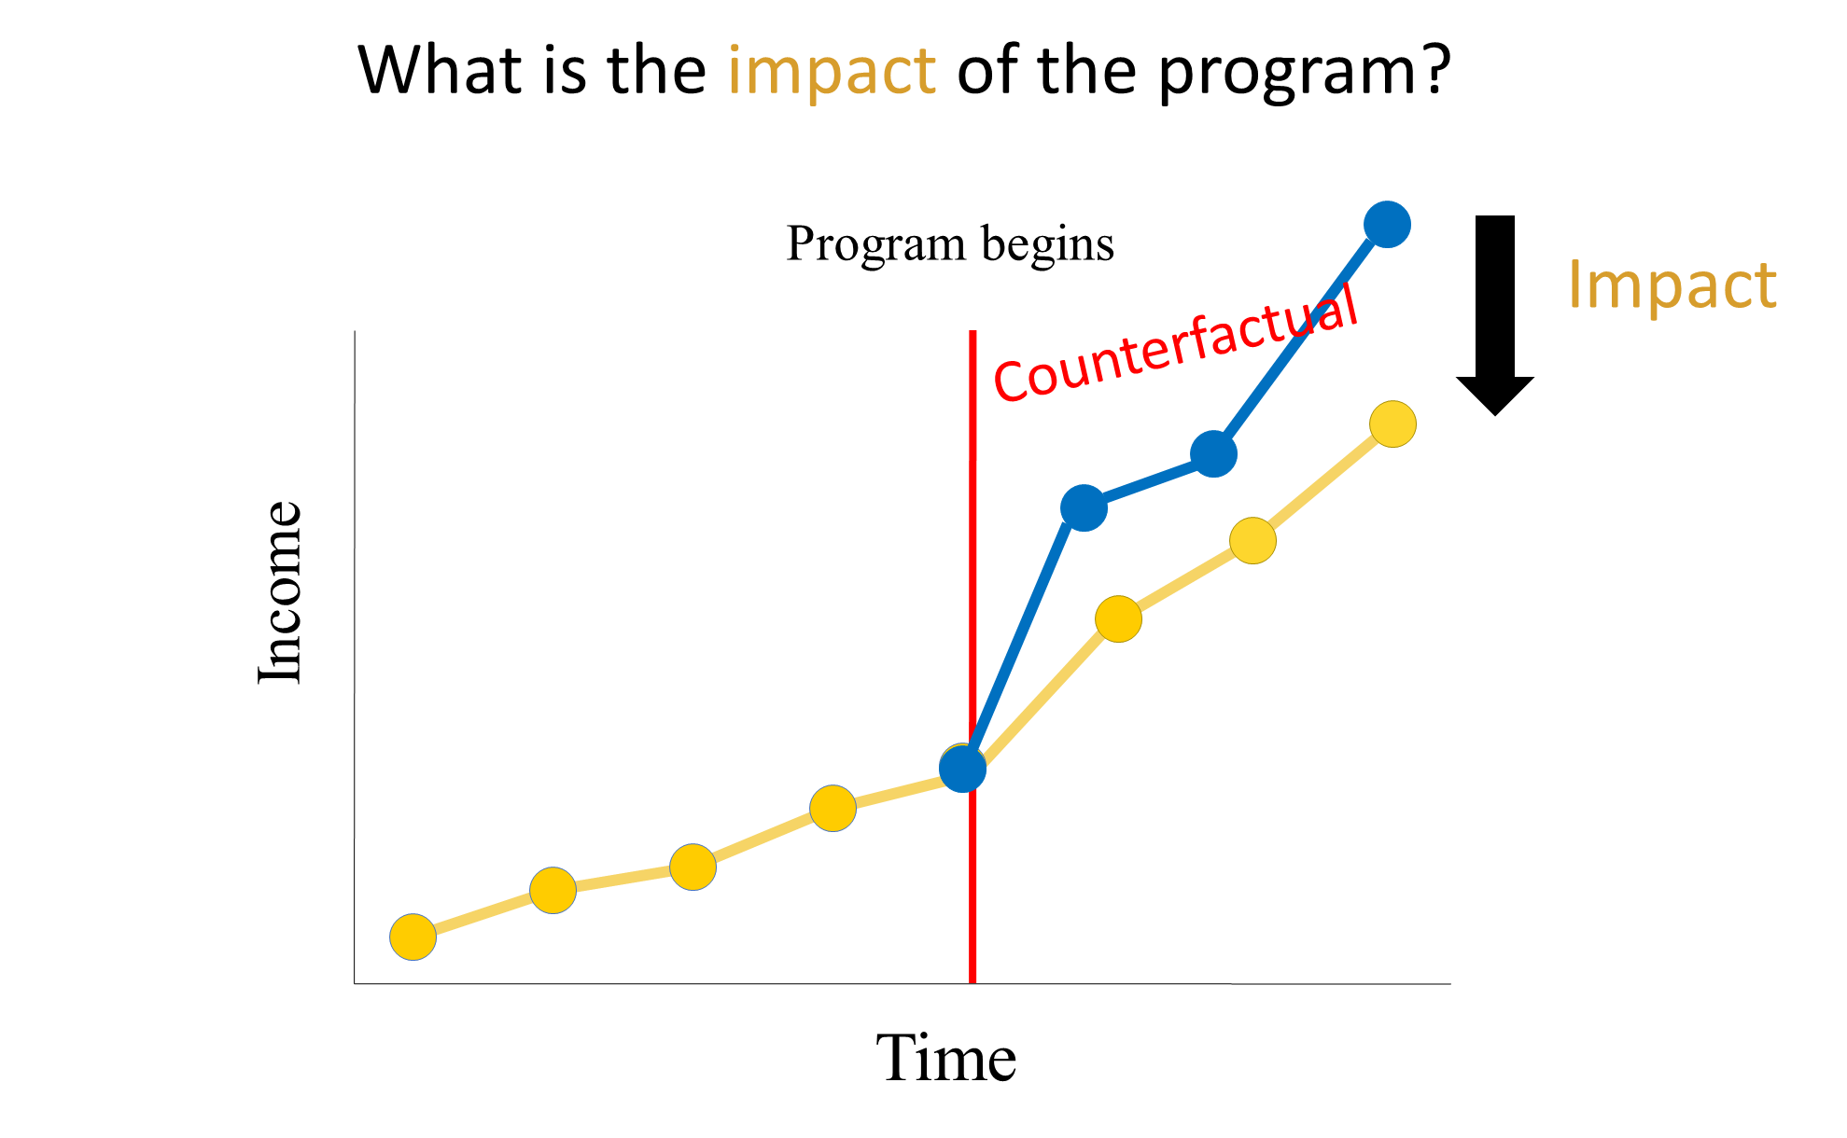
Understanding Impact

Slide 12
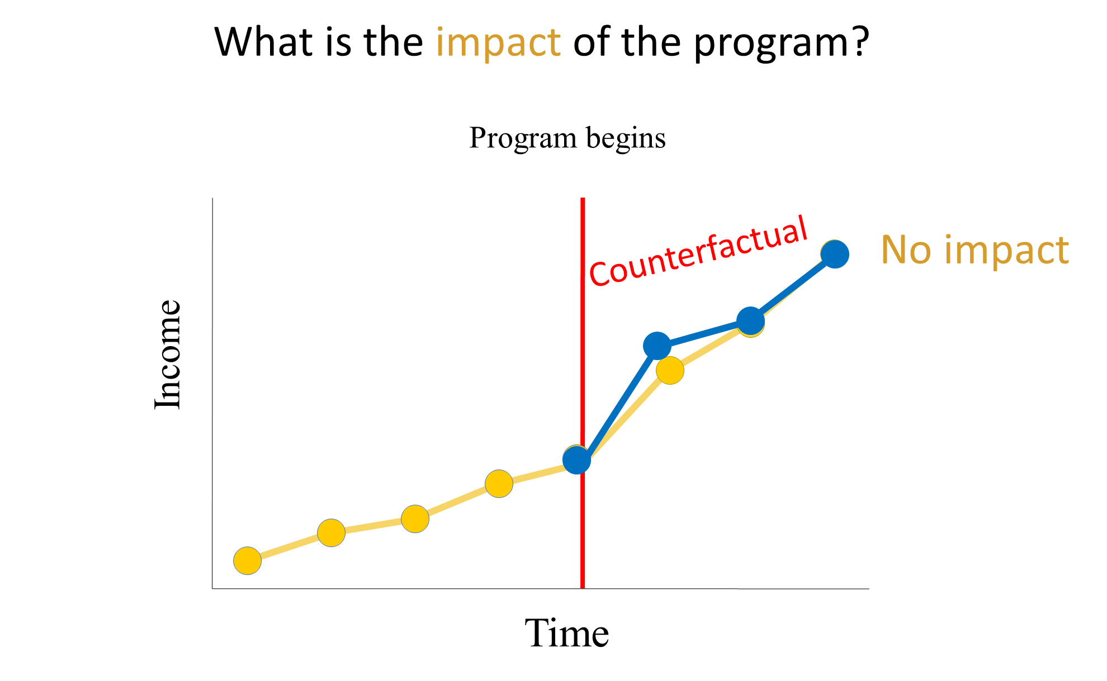
Understanding Impact

Slide 13
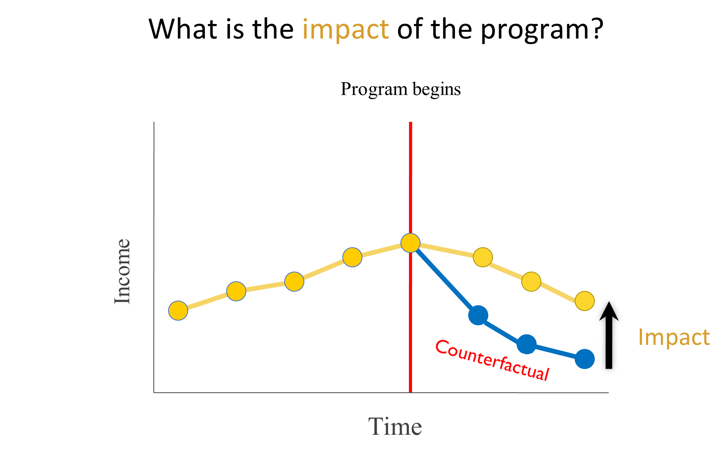
Understanding Impact

Slide 14
Understanding Impact
Counterfactual: represents the state of the world that program participants would have experienced in the absence of the program (i.e. had they not participated in the program)
Problem: Counterfactual cannot be observed
Solution: We need to “mimic” or construct the counterfactual

Slide 15
Constructing a counterfactual
Understanding Impact
Select a group not affected by the program
= comparison group / control group
How this group is selected is a key decision in the design of any impact evaluation.

Slide 16

Selecting the comparison group
Understanding Impact
Idea: Select a group that is identical to the group of participants in all ways except one: their exposure to the program being evaluated
Goal: To be able to attribute differences in outcomes between the participants and the comparison group to the program (and not to other factors)

Slide 17
Understanding Impact
An impact evaluation is only as good as the comparison group it uses to mimic the counterfactual

Slide 18

Understanding Impact
What are the problems of the comparison groups in the following examples?
Are we comparing apples with apples?

Slide 19
A remedial education program
Understanding Impact
Students with math test scores below a certain threshold are provided with one-hour after school tutoring with targeted instruction. After one year, we compare endline math test scores between:
Treatment group: students who received the program
Comparison group: students who did not receive the program

Slide 20
A business management training program
Understanding Impact
A group of female micro-entrepreneurs are offered a training program to support them in better managing their enterprises. After one year, we compare business income between:
Treatment group: women who signed up and attended the training
Comparison group: women who did not sign up for the training

Slide 21
A livelihood program
Understanding Impact
Social workers visit households locating in different parts of a community to select 50% of them, to offer a livelihood program. After one year, we compare household income between:
Treatment group: households enrolled in the livelihood program
Comparison group: households not enrolled in the livelihood program

Slide 22
Randomized Controlled Trial (RCT)

Slide 23

What is RCT
TREATMENT GROUP
INTERVENTION
Program candidates
Randomly split into 2 groups by
Lottery
Outcomes of
interest
NO INTERVENTION
CONTROL GROUP

Slide 24

Randomized Controlled Trial
What is RCT
With a large enough sample size, groups (treatment and control) that are chosen at random do not differ systematically at the outset of the experiment.
Treatment
Control

Slide 25
Randomized Controlled Trial
What is RCT
Do not differ systematically on characteristics that are……
Observable
Age
Gender
Income
Grade level
Unobservable
Motivation
Toughness
Optimism
Talent
Treatment
Control

Slide 26
Randomized Controlled Trial
What is RCT
With a large enough sample size, groups (treatment and control) that are chosen at random do not differ systematically at the outset of the experiment.
Any difference that subsequently arises between them can be attributed to the program rather than to other factors.

Slide 27
Example of Randomizing a Government Program

Slide 28
KASAMA Program Evaluation by DOLE
Example RCT
Total sample: 164 communities/villages
Eligibility
The program had not been implemented there before
The government was planning to roll out the program in a phased approach
Local governments supportive of RCT
Randomization / Lottery
82 villages will receive the program during evaluation period
82 villages will receive the program after the evaluation period
https://www.amherst.edu/system/files/Edmonds_Theoharides_Kasama_final.pdf

Slide 29
KASAMA Evaluation Design
Example RCT
TREATMENT GROUP
INTERVENTION
164 villages
Child labor
Economic activity
Consumption
Randomly split into 2 groups by
Lottery
NO INTERVENTION
CONTROL GROUP

Slide 30
Pre-analysis plan for transparency
Example RCT
Basic Information
Relevant parties: authorship, partner institutions
Objective of the study
Study Design
Hypotheses to be tested
Main variables of interest - primary & secondary outcomes
Treatment - including measurement of treatment effect
Methodology - RCT? Natural experiment?
Data sources - in-person interviews? Administrative data?
Sampling frame - inclusion/exclusion criteria, unit of analysis

Slide 31
Example RCT
TREATMENT GROUP
INTERVENTION
164 villages
Child labor
Economic activity
Consumption
Randomly split into 2 groups by
Lottery
NO INTERVENTION
CONTROL GROUP
Sample size: 14 households * 164 villages = 2296 households
Baseline survey

Slide 32
Example RCT
TREATMENT GROUP
INTERVENTION
164 villages
Child labor
Economic activity
Consumption
Randomly split into 2 groups by
Lottery
NO INTERVENTION
CONTROL GROUP
Sample size: 14 households * 164 villages = 2296 households
Baseline survey
Balance check

Slide 33
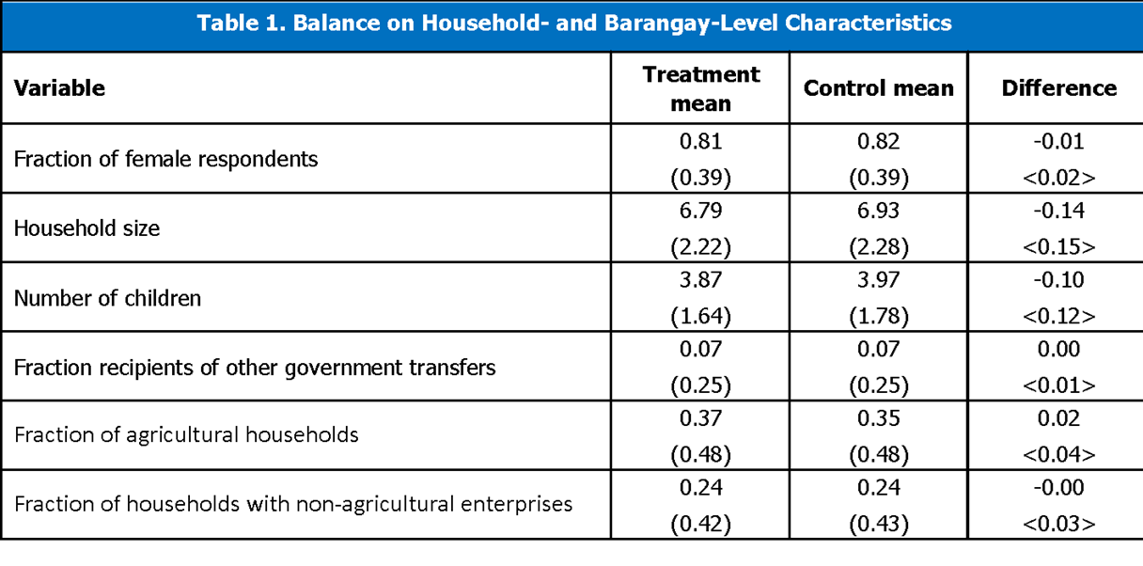
Balance table
Example RCT
Standard deviation in parentheses. Statistics displayed for Regions I, II, III, IV-A, and V.
*/*/***: Statistically significant at the 10% / 5% / 1% level
Source: Edmonds, et al. (2016). Impact Evaluation of KASAMA Program: Baseline Report.

Slide 34
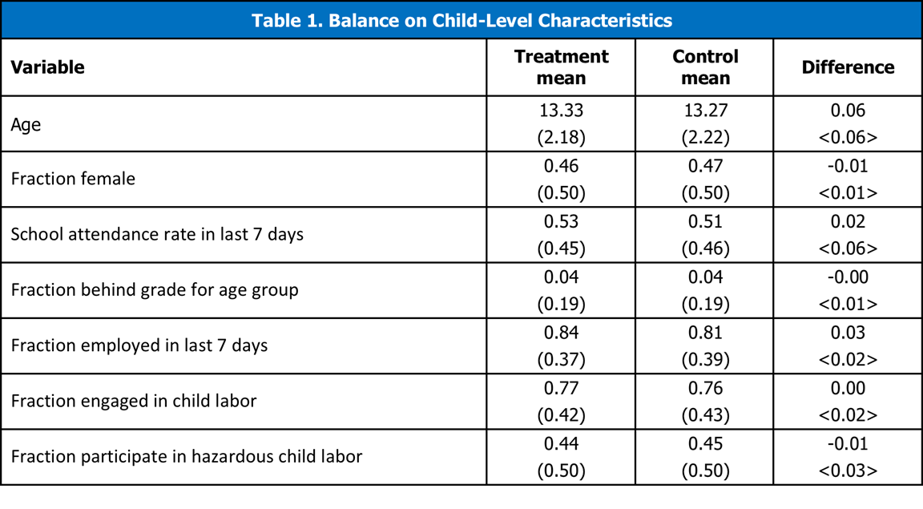
Balance table
Example RCT
Standard deviation in parentheses. Statistics displayed for Regions I, II, III, IV-A, and V.
*/*/***: Statistically significant at the 10% / 5% / 1% level
Source: Edmonds, et al. (2016). Impact Evaluation of KASAMA Program: Baseline Report.

Slide 35
Mechanics of Randomization
Need sample frame
Pull out of a hat/bucket; or
Use random number generator in spreadsheet program to order observations randomly; or
Stata/R program code
What if no existing list?

Slide 36
Example RCT
TREATMENT GROUP
INTERVENTION
164 villages
Child labor
Economic activity
Consumption
Randomly split into 2 groups by
Lottery
NO INTERVENTION
CONTROL GROUP
Sample size: 14 households * 164 villages = 2296 households
Baseline survey
Balance check
Intervention monitoring - compliance with research design

Slide 37
Example RCT
TREATMENT GROUP
INTERVENTION
164 villages
Child labor
Economic activity
Consumption
Randomly split into 2 groups by
Lottery
NO INTERVENTION
CONTROL GROUP
Sample size: 14 households * 164 villages = 2296 households
Baseline survey
Balance check
Intervention monitoring - compliance with research design
Endline survey

Slide 38
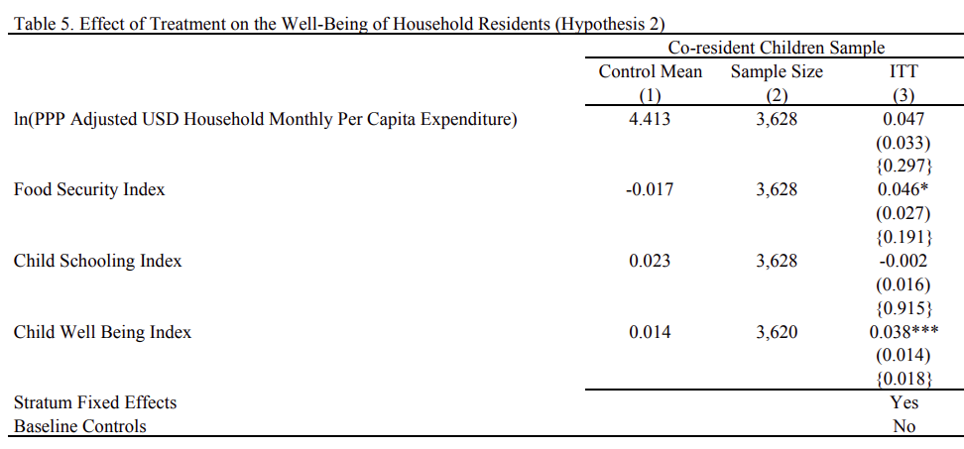
Estimate impact
Example RCT

Slide 39
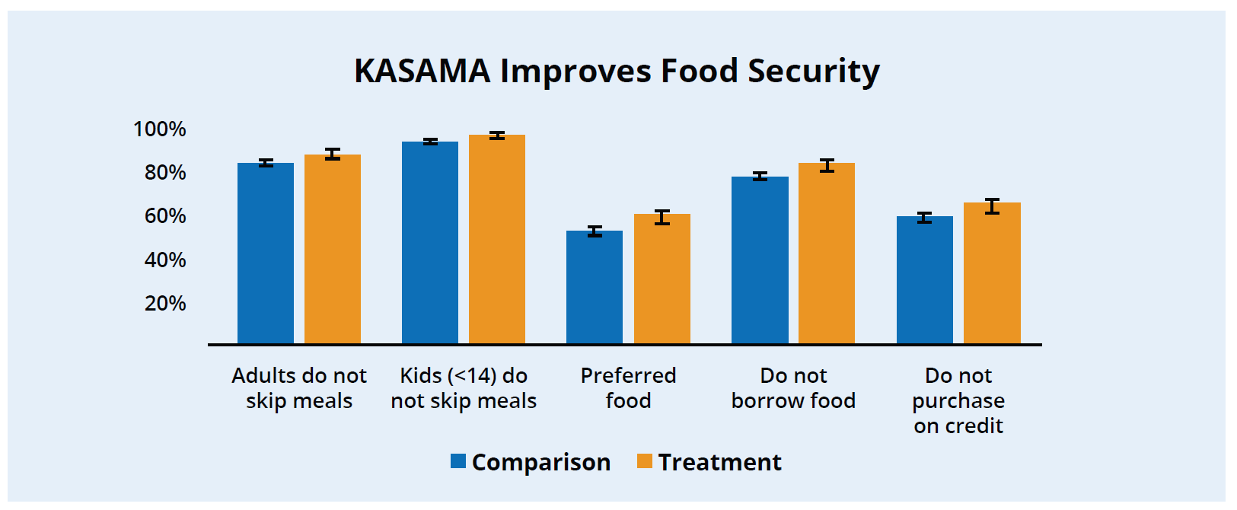
Estimate impact
Example RCT

Slide 40
Key Steps in Conducting an RCT
Example RCT
Design study carefully
Random assignment (treatment & control)
Baseline data collection
Check for balance
Monitor for integrity of implementation / evaluation
Follow up data collection
Estimate impact (treatment vs. control)
Assess statistical & practical significance

Slide 41
How to Design an RCT?

Slide 42
Considerations for RCT Design
Designing RCT
Unit of randomization
Real world constraints
Types of RCT
Sample size determination

Slide 43
Unit of Randomization
Designing RCT
Randomize at the individual level?
Randomize at the group level?
Other levels?
What are the implications?

Slide 44
Unit of Randomization
Designing RCT
What unit does the program target?
Individual participants?
Households?
Communities?
Schools?
What is the unit of analysis?
What outcomes do we care about?
At what level can we measure them?

Slide 45
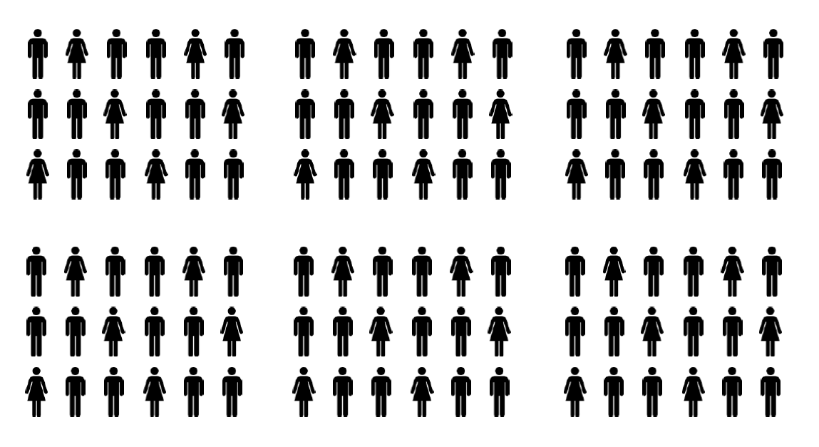
Unit of Randomization
Designing RCT

Slide 46
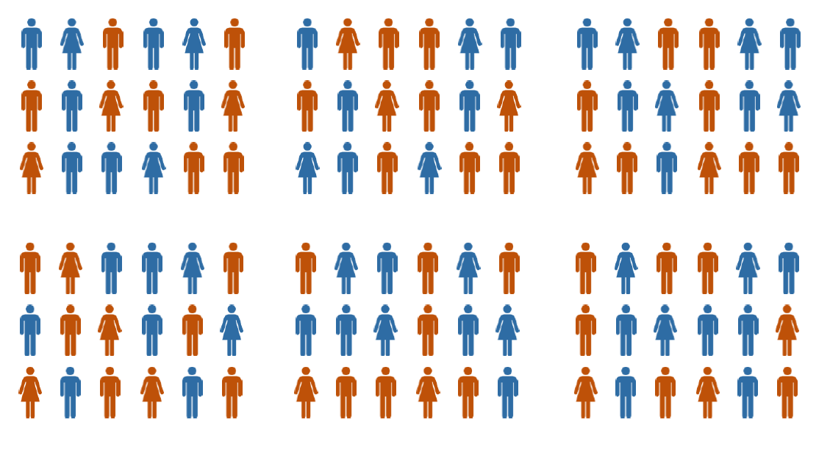
Unit of Randomization - Individual?
Designing RCT

Slide 47
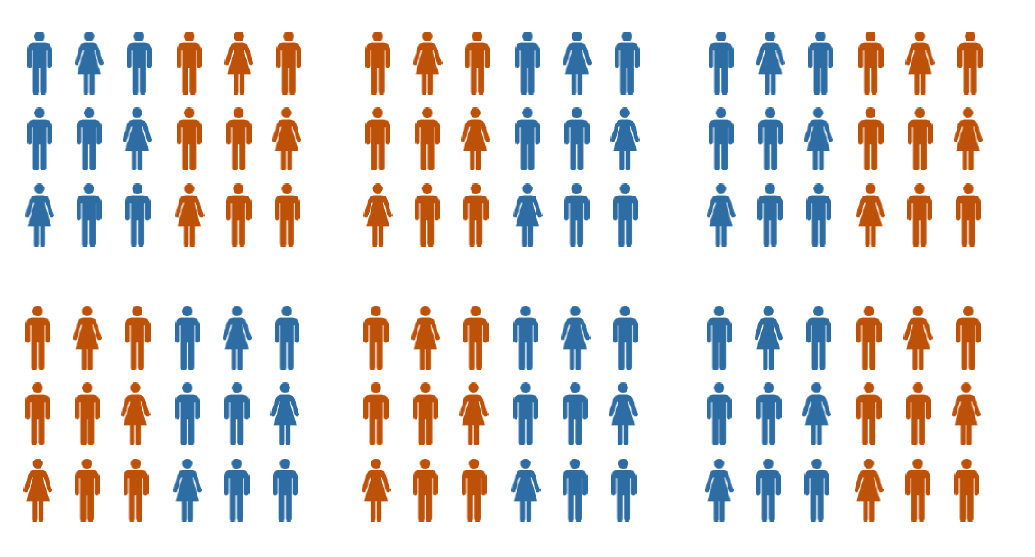
Unit of Randomization - Class?
Designing RCT

Slide 48
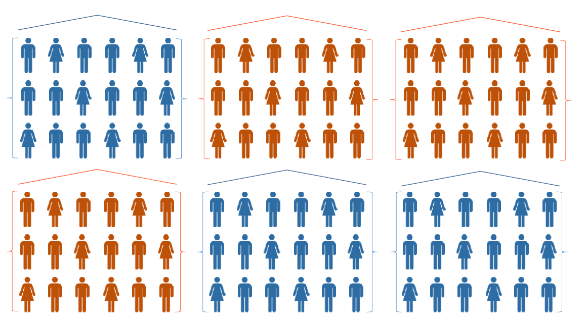
Unit of Randomization - School?
Designing RCT

Slide 49
Unit of Randomization - How to Decide?
Designing RCT
Nature of the program
How is the intervention administered?
What is the “catchment area” of each unit of intervention?
How wide is the potential impact?
Sample size
If randomize at village level, are there enough villages?
Spillovers/contamination
If randomize within a class/a community, how likely will beneficiaries share treatment (information, assets, etc.) with those in the control group?

Slide 50
Real World Constraints - Fairness
Designing RCT
Randomizing at the individual level within a farmers’ association
Non-treated farmers might be unhappy
Randomizing at the household-level within the community
Non-recipient households or the village chief might be unhappy
Randomizing at the community or farmers’ association level
Ministry of Agriculture might be unhappy

Slide 51
Real World Constraints - How to respond to the fairness concerns?
Designing RCT
Most programs have limited resources → more eligible recipients than resources will allow services for.
Randomization is a simple, fair and transparent way to select program beneficiaries

Slide 52
Real World Constraints - Logistics
Designing RCT
Need to recognize logistical constraints in research designs.
For example - individual deworming treatment by health workers
Health workers have many responsibilities, not just deworming → may want to randomize at school level
Health workers serve members from both T and C groups - prone to errors → may want to randomize services provider rather than clients

Slide 53
Types of RCTs
Designing RCT
How to randomize:
Simple lottery
Phase-in
Encouragement design
Treatment groups:
Multiple treatments
Cross-cutting treatments

Slide 54
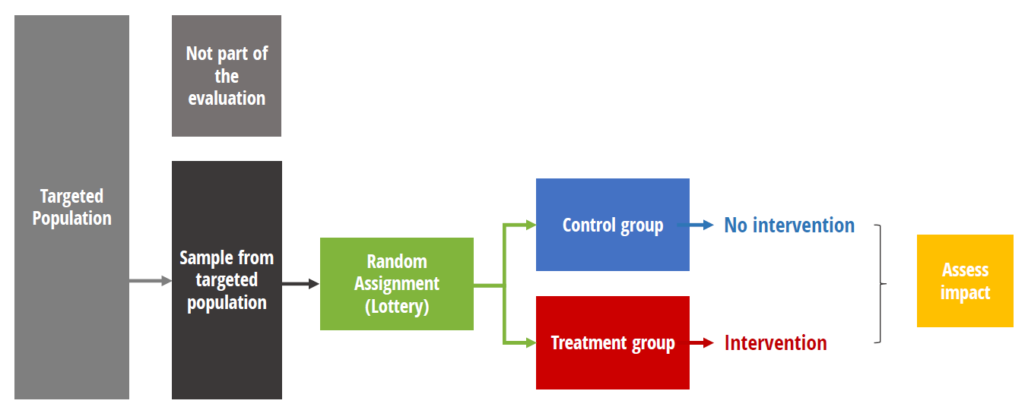
Simple Lottery
Designing RCT

Slide 55
Phase-in Design
Designing RCT
Everyone gets the program at some point -> Extremely useful for experiments where everyone will / should get the treatment
Natural approach when expanding program faces resource constraints

Slide 56
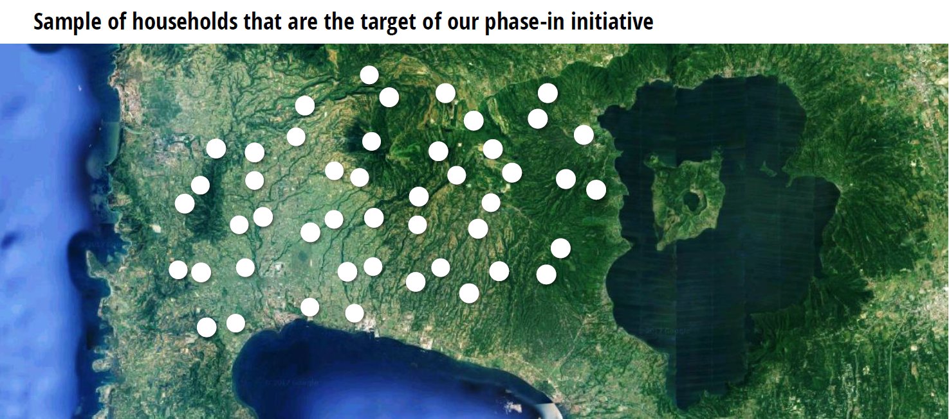
Designing RCT

Slide 57
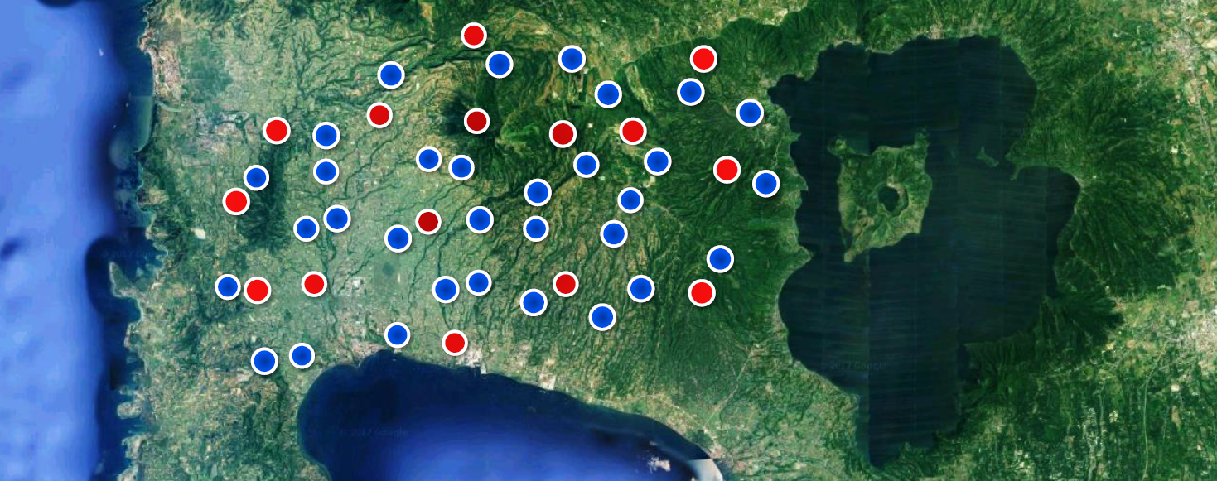
Designing RCT
Year 1
Treatment: 1/3rd
Control: 2/3rds

Slide 58
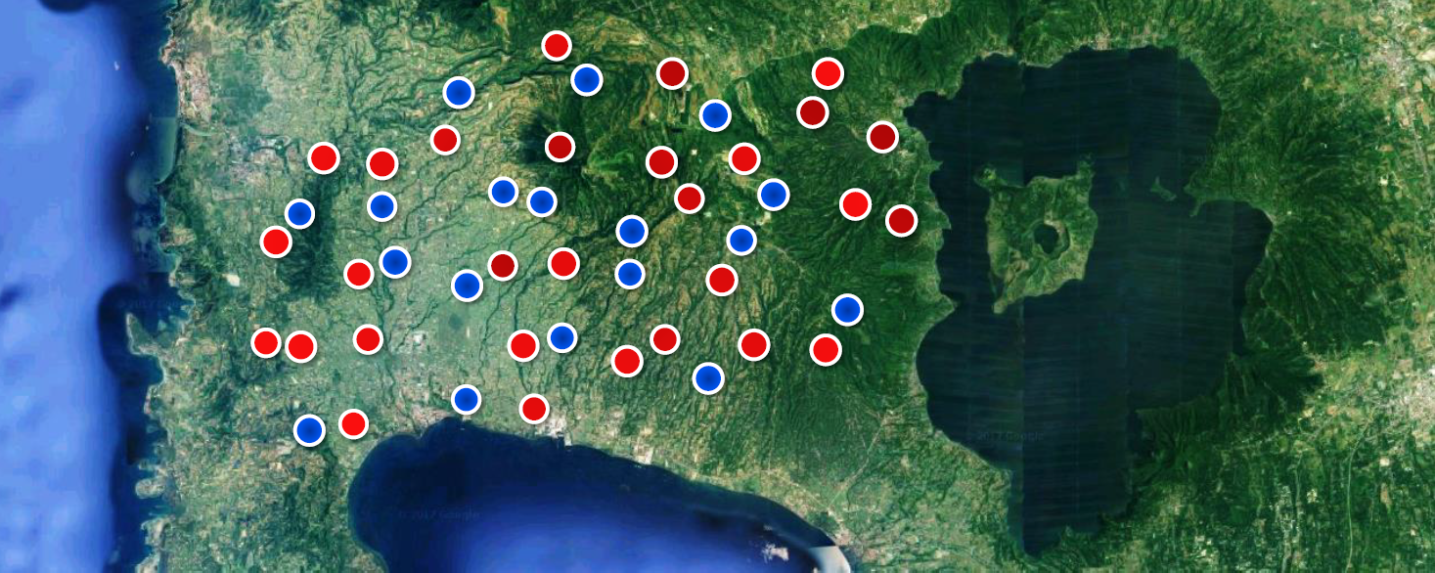
Designing RCT
Year 1
Treatment: 1/3rd
Control: 2/3rds
Year 2
Treatment: 2/3rds
Control: 1/3rd

Slide 59
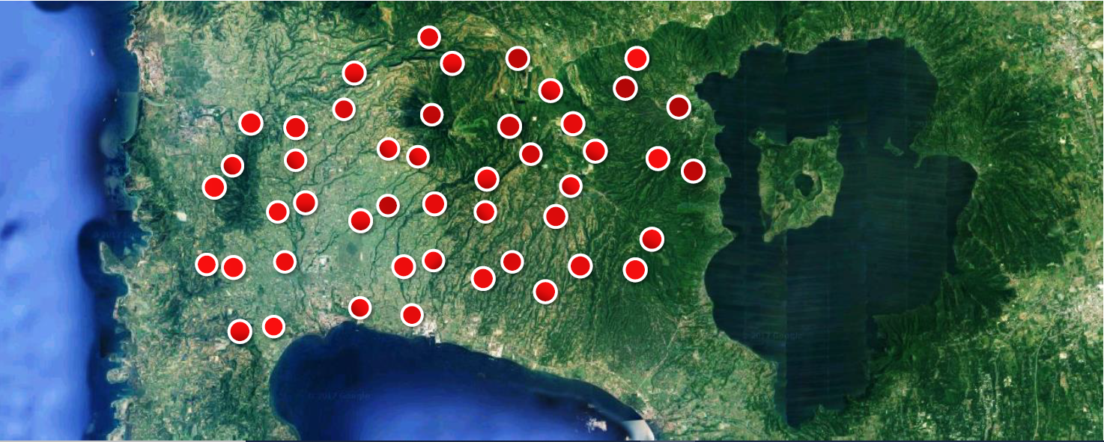
Designing RCT
Year 1
Treatment: 1/3rd
Control: 2/3rds
Year 2
Treatment: 2/3rds
Control: 1/3rd
Year 3
Treatment: all
Control: 0
Evaluation
Ends

Slide 60
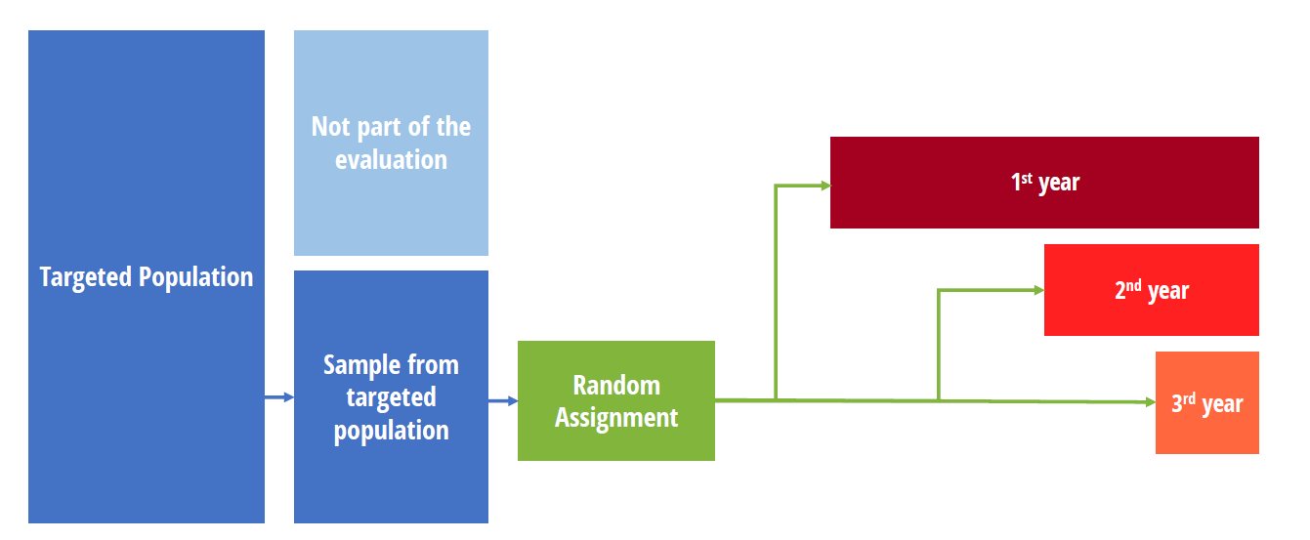
Phase-in Design
Designing RCT

Slide 61
Phase-in Design
Designing RCT
Counterfactual:
1st year: those who will receive the intervention in 2nd year or 3rd year
2nd year: those who will receive the intervention in 3rd year
Advantages
Everyone gets something eventually
Concerns
Can complicate estimating long run effects
Do expectations change actions today?

Slide 62
Encouragement Design
Designing RCT
What to do when access can’t be randomized?
Sometimes it’s impractical or unethical to randomize program access
But: most programs have less than 100% take-up
Random assignment of encouragement to sign up to treatment → differential take-ups between treatment and control groups

Slide 63
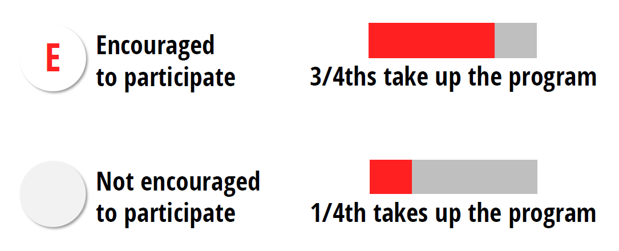
Key → Differential Take-ups
Designing RCT
Treatment group
Control group

Slide 64
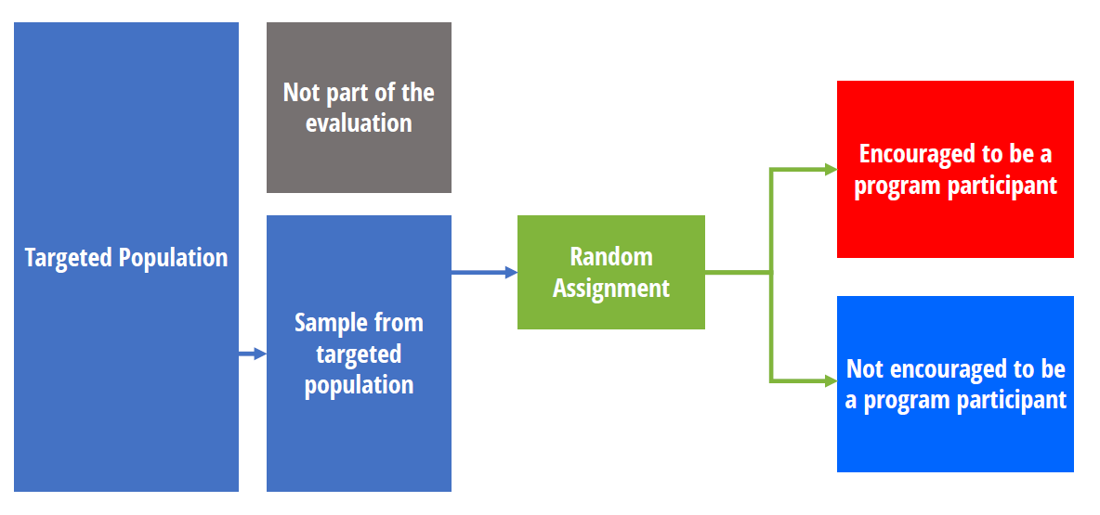
Encouragement Design
Designing RCT

Slide 65
Encouragement Design
Designing RCT
What comparison are we making?
Those who are encouraged vs. those who are not
Participant vs. non participant
Compliers with encouragement vs. non compliers with encouragement

Slide 66
Encouragement Design
Designing RCT
Advantages
Can use randomization even if access cannot be restricted
Can randomize at individual level even when the program is not administered at that level
Concerns
Measures impact on those who respond to the incentive
Need large enough inducement to improve take-up → pilot test the effectiveness of the encouragement strategy first
Encouragement itself may have direct effect on outcomes → design encouragement carefully, factor this in analysis

Slide 67
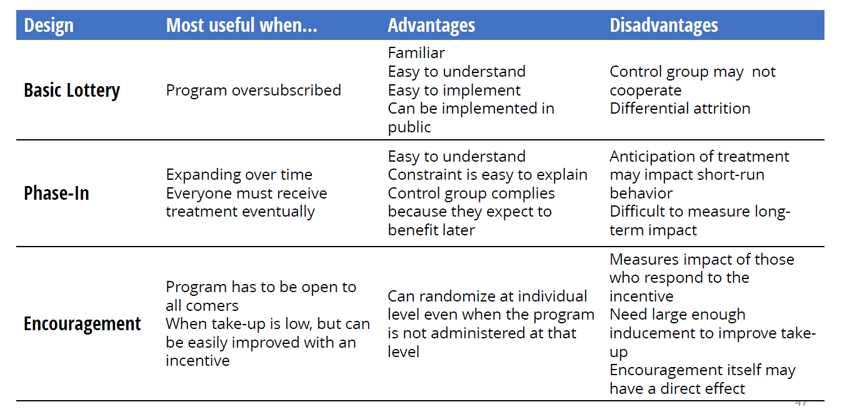
Designing RCT

Slide 68
Multiple Treatment Groups
Designing RCT
Sometimes the core question not just whether an intervention work or not but → deciding among different possible interventions
You can randomize these interventions
This can tell us about the relative benefit of one intervention compared to another
Consider cost-effectiveness

Slide 69
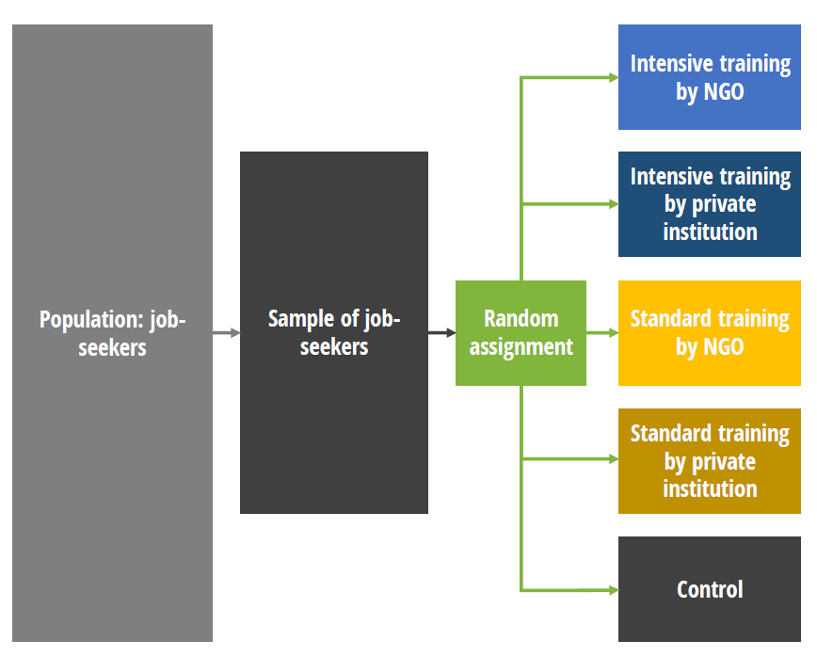
Testing intervention variations and delivery models
Designing RCT

Slide 70
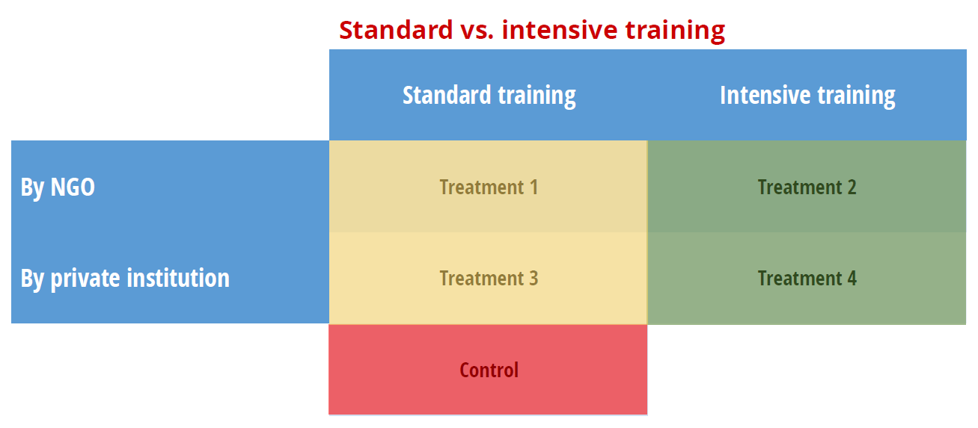
Testing intervention variations and delivery models
Designing RCT

Slide 71
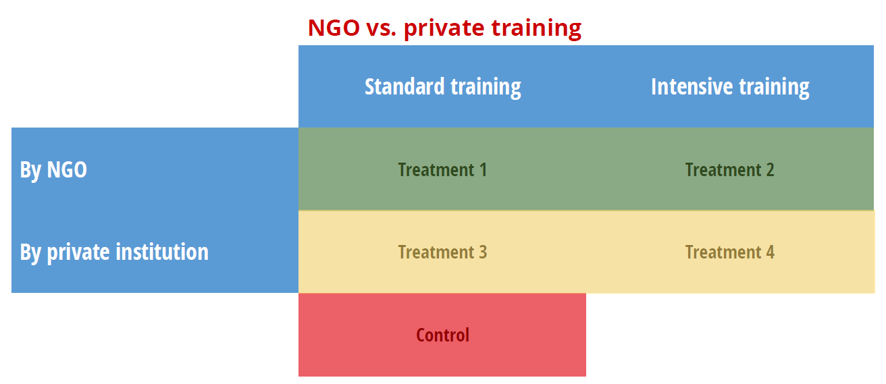
Testing intervention variations and delivery models
Designing RCT

Slide 72
Cross-cutting Treatments
Designing RCT
Test different components of treatment in different combinations
Test whether components serve as substitutes or complements
What is most cost-effective combination?
Advantage: win-win for operations, can help answer questions for them, beyond simple “impact”!

Slide 73
Cross-cutting Treatments
Designing RCT
Example: nutrition interventions for 1000-day households
Cash transfer + community-based behavioural change communication (BCC)
Cash transfer + household level BCC
Cash transfer only
Control
Does BCC lead to significantly higher impact, on top of cash transfer? If yes…
Does household level BCC lead to significantly higher impact than the much cheaper community-level approach?

Slide 74
Considerations of multiple-treatment design
Designing RCT
Consider sample size constraint → the more treatment groups, the larger a sample size you will need
Consider resource constraint
Prioritize most policy-relevant research questions → consult evidence in existing literature

Slide 75
When RCT
Designing RCT
How do I know what is the needed
sample size?

Slide 76
Population and sample
Designing RCT
Control
Random sampling
Treatment

Slide 77
True and estimated effect size
Designing RCT
True treatment effect: the true population difference in the outcome with and without the program
Fundamentally unknowable
Estimated treatment effect: the sample difference in the outcome between the treatment and control group
The estimated effect size depends on the specific sample in your RCT

Slide 78
Sampling variation and treatment effect
Designing RCT
Randomization guarantees that the treatment and control groups are not systematically different. However, they may still be different.
Is the difference between groups due to chance variation or an effect of the program?
Control
Random sampling
Treatment

Slide 79
Sampling variation and treatment effect
Designing RCT
The larger the sample, the more likely it is that the two groups are similar to each other and similar to the overall population
Difference is more likely to be due to an effect of the program
Control
Random sampling
Treatment

Slide 80
Determining Sample Size
When RCT
Designing RCTc
We want to ensure that the sample size is large enough to distinguish whether observed differences between treatment and comparison groups are due to chance or due to an impact of the program
Too small: risk of overlooking a true effect
Too large: unnecessary use of resources
The power of a study tells us something about the relationship between the sample size and the risk of overlooking true effects.
Power calculations can help us determine what sample size has a “good chance” of picking up an effect (if there is one)!

Slide 81
Power calculation
When RCT
Designing RCT
The ability of an RCT to detect differences between the treatment and the control groups is measured by statistical power.
Power calculations involve either
determining the sample size needed to detect the minimum detectable effect (MDE) given other parameters, or
determining the effect size that can be detected given a set sample size and other parameters.
Detailed technical resources: https://www.povertyactionlab.org/resource/power-calculations

Slide 82

Power calculation
When RCT
Designing RCT
The sensitivity of an experiment to detect differences between the treatment and the control groups is measured by statistical power.
Power calculations involve either (1) determining the sample size needed to detect the minimum detectable effect (MDE) given other parameters, or (2) determining the effect size that can be detected given a set sample size and other parameters.
More power
Smaller MDE
Detailed technical resources: https://www.povertyactionlab.org/resource/power-calculations

Slide 83
Components of power calculation
When RCT
Designing RCT
Components of power calculations include:
Significance: Typically set at 5% (meaning you are 95% confident the results identified in the RCT are not just by chance)
Power: Typically set at 0.8 (acceptable level of power)
Minimum detectable effect (MDE): Minimum magnitude of changes that the RCT can detect
Sample size
Variance of outcome variable: How much does the outcome varies across your population
Treatment allocation: Equal number of units in each group or not
Intra-cluster correlation coefficient: How similar are units within the sample cluster (e.g. HHs in the same barangay)
Stata/R codes:
https://github.com/J-PAL/Sample_Size_and_Power

Slide 84
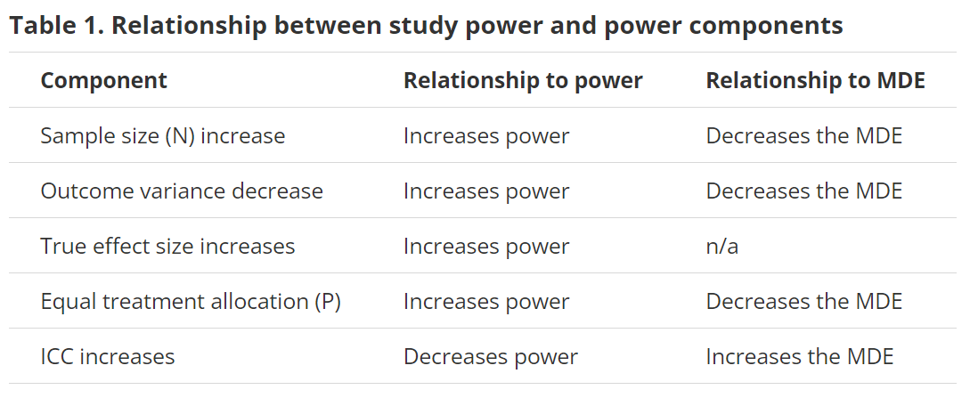
When RCT
Designing RCT

Slide 85
Components of power calculation
When RCT
Designing RCT
Take-up, noncompliance, and attrition: Noncompliance effectively dilutes the treatment effect estimate, with either the treatment group including units that were not treated, the control group including units that were treated, or both. This requires a larger sample size to detect the MDE.

Slide 86
Power calculation - practical tips
When RCT
Designing RCT
Some components of power calculations are based on decisions or assumptions made by the researcher and partner, while others are calculated using existing data.

Slide 87
Power calculation - practical tips
When RCT
Designing RCT
Based on decisions or assumptions
MDE may be a practically relevant effect size such as the minimum improvement in outcomes required for the implementing partner to determine the program’s benefits are worth the costs or to scale the program.
Expected effect size should be adjusted to the expected compliance rate in the two groups.
If information about realistic effect sizes is not available, rules of thumb:
0.2 standard deviations for a small MDE
0.5 standard deviations for a medium MDE
0.8 standard deviations for a large MDE
*Also helpful to check effect size of published RCTs on similar interventions

Slide 88
Power calculation - practical tips
When RCT
Designing RCT
Based on decisions or assumptions
Alternatively, the sample size may be determined by the study budget or a partner’s constraints (e.g., number of eligible students in the partner’s schools, the number of health clinics in the district, etc.).
Number of clusters and size of each cluster: It is typically cheaper to interview one more person in an existing cluster than add a new cluster due to logistical constraints (transportation, personnel costs etc.). However, there is also a decreasing marginal power from each additional unit within the same cluster.

Slide 89
Power calculation - practical tips
When RCT
Designing RCT
Using existing data
Outcome variance is ideally found in baseline data. If that is not available, it may be calculated using other data in the same or a similar population, or found in papers from studies on similar topics, preferably among similar populations.
ICC: Similarly, the ICC can be estimated using data from baseline data, surveys, and papers--all preferably in the same or a similar population.
Take-up, compliance, and attrition: Literature from previous programs similar to the one under study can give a rough idea of plausible levels of take-up. Note that such literature need not be restricted to academic papers but can also include white and gray literature, reports, etc.

Slide 90
Power calculation - practical tips
When RCT
Designing RCT
Invest in getting the right expertise to carry out reliable power calculation → running an underpowered RCT is a waste of time and resources!
Run initial calculations with the best data that is readily accessible, and continue to refine the calculations
Program implementers’ inputs are very important → no researchers can get the power calculation right without working with implementers
Realistic sample size, allocation of treatment and unit of randomization from a programmatic perspective
Meaningful minimum detectable effects

Slide 91
When (not) to Run an RCT?

Slide 92
Is an RCT needed?
When RCT
Is there an important policy question to answer?
Is the evidence limited?
Has positive impact been proven using rigorous methodology? If so, are there resources to cover everyone?

Slide 93
How do I know whether evidence from other studies will apply in my program contexts?

Slide 94
What makes good quality evidence?
When RCT
Peer-reviewed
Experimental evidence on effectiveness of interventions
Clear description of research design, process and analysis → the more transparency the better
Availability of a pre-analysis plan (AEA RCT Registry)

Slide 95
Generalizability - examine your theory of change against the evidence
When RCT
Are there any economic/political/social/cultural/contexts that made a program work which we need to consider while applying the evidence in our context?
Revisit assumptions in your theory of change!

Slide 96
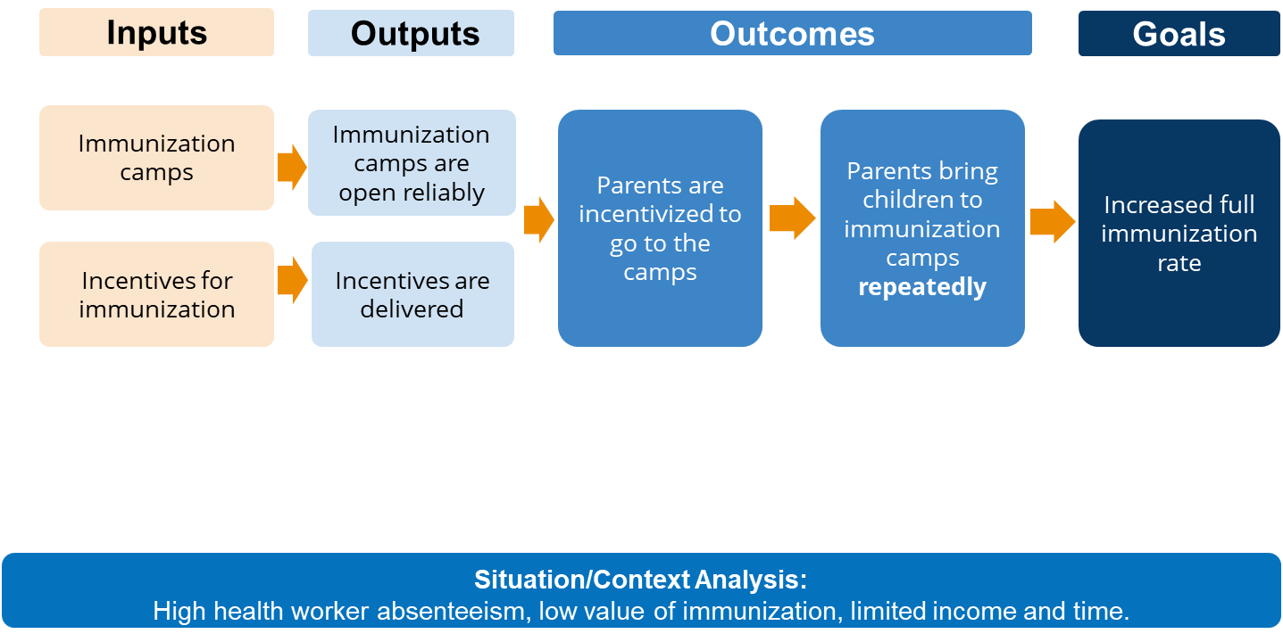
Theory of change of an immunization program

Slide 97
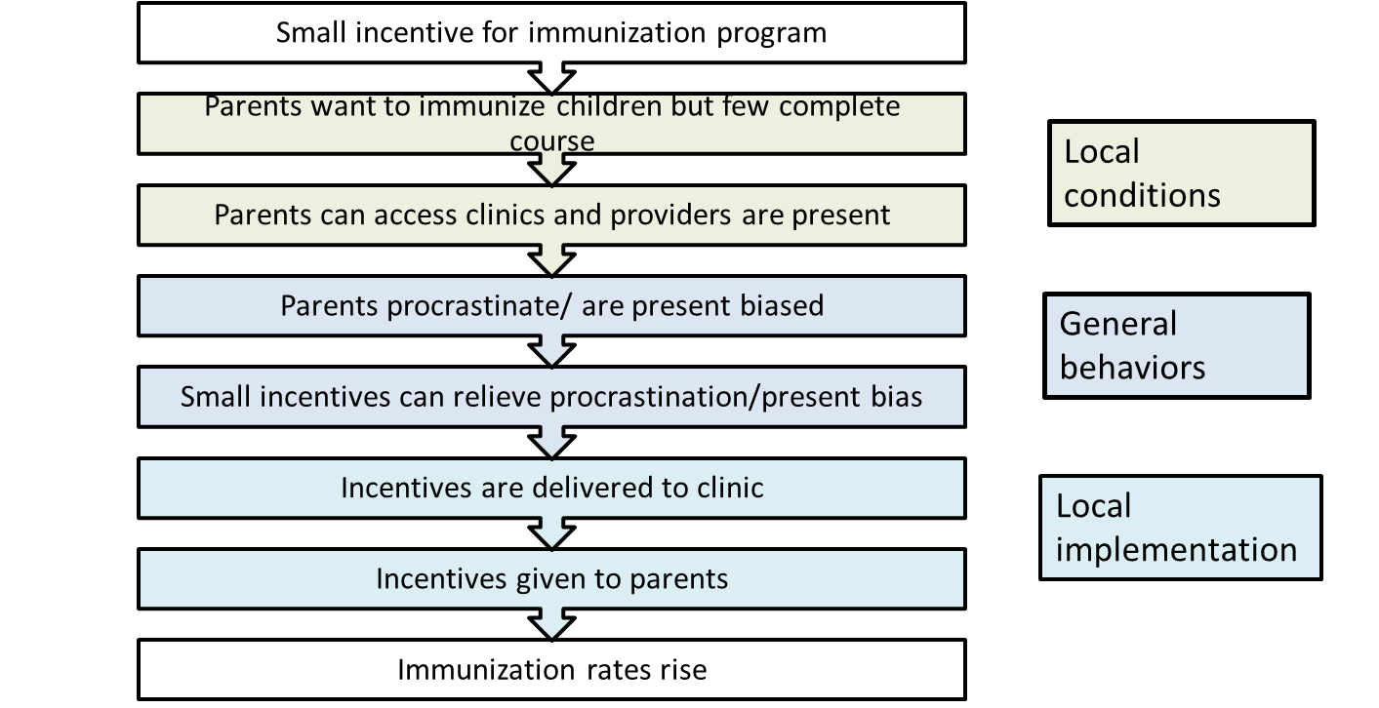
Should we recommend incentives for immunization?

Slide 98
Is the timing right for an RCT?
When RCT
Is it too late?
Has program implementation started? If so, are there plans to expand the program to new geographies/population?
Is it too early?
Is the program so young that you don’t even know whether it can be implemented well? Implementation failure vs. theory failure
Is a process evaluation needed to first confirm that program can be and is being implemented as planned?

Slide 99
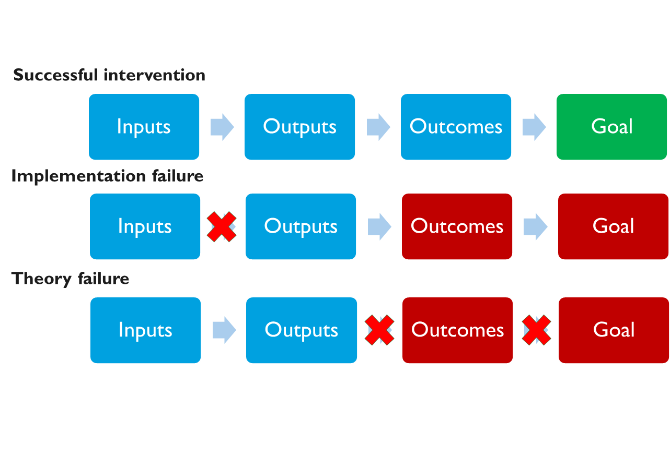
When RCT

Slide 100
Is an RCT feasible?
When RCT
Is there time, expertise, and money to do it right?
Will attrition and spillovers be manageable?
Is there sufficient sample size?
Unit of randomization
Expected effect size
Take-up

Slide 101

How much does an RCT cost?

Slide 102
It may be more appropriate to ask “How much will data collection cost?”
When RCT
Regardless of methodology (RCT or not), collecting good quality data is usually not cheap
But making decisions based on bad quality data is just as bad as not having data!
Consider innovative ways to collect good quality but cheaper data
Take advantage of administrative data
Remote data collection
High-frequency SMS-based reporting of maze market price in Malawi (International Food Policy Research Institute)

Slide 103
It may be more appropriate to ask “How much will data collection cost?”
When RCT
With IPA standard data collection protocols (digitized data collection, sufficient piloting, sufficient training and in-field supervision, at least 10% audit)
A 1-hour face-to-face baseline survey with 1,500 households in 150 villages could cost 50,000 - 100,000 USD
In addition:
Staff time or consultant for research design, data management and analysis?
Devices, softwares and field supplies?

Slide 104
Thought exercise: designing RCT for a fictional program

Slide 105
An NGO has a flagship livelihood program that has been implemented in some parts of the Philippines for a few years. They provide seed capital or productive assets for beneficiary households to start their livelihood project. They also train the households to better manage their livelihood projects and be more successful.
Now the NGO plans to expand the program to 50 new barangays.
Meanwhile, the NGO wants to learn more about how to improve program design:
They have been providing one-on-one training for livelihood management. But will group-level training work as well?
They recently developed a new training module on financial management, which they believe could be complementary to the existing training, but want to learn how effective it is before incorporating it to all their program sites.

Slide 106
What questions will you ask the implementer before designing the evaluation?

Slide 107
How will you design this RCT?
What is the unit of randomization?
Which type of RCT?
What are the treatment groups?
……..?

Slide 108
Key Takeaways
Key Takeaways
An impact evaluation is only as good as the comparison group it uses to mimic the counterfactual
Randomized controlled trial (RCT) is the most credible way to construct a counterfactual and estimate impact of a program, but it should be designed before program roll out, not at the end of a program
RCT is not always needed and feasible – consider the policy question and context of program before deciding to run an RCT

Slide 109
Resources
Key Takeaways
Practical resources for designing and running randomized evaluations: https://www.povertyactionlab.org/research-resources?view=toc
Policy insights briefs: https://www.povertyactionlab.org/policy-insights
IPA studies https://poverty-action.org/our-studies#news_filter
JPAL studies https://www.povertyactionlab.org/evaluations
AEA RCT registry https://www.socialscienceregistry.org/

Slide 110
skochhar@poverty-action.org

Slide 111
Quizzes
To understand the impact of a program, we can simply compare the outcomes before and after the program. True/False/It depends
To understand the impact of a program, we can simply compare the outcomes between those who participate in/receive the program and those who do not. True/False/It depends
As long as an evaluation uses random sampling approach, it is a randomized controlled trial. True/False
In a randomized controlled trial, the group that receive the program is called the “treatment group”. The group that do not received the program is called…?
Control group
Comparison group
All of the above
Which factors should be considered when determining the unit of randomization for a randomized controlled trial? (select all that apply)
Sample size
Spillover/contamination
Logistical feasibility
At which level is the program administered?

